Slide 1


The Power, Awe and Wonder of the Human Voice

Slide 2

Aims and Objectives
To practically explore the physiology of the voice.
  To explore songs and vocal exercises, which help develop pitch recognition and vocal range.
  To explore vocal exercises and activities which encourage healthy vocal technique.
To understand the components of a good vocal warm up.

Slide 3
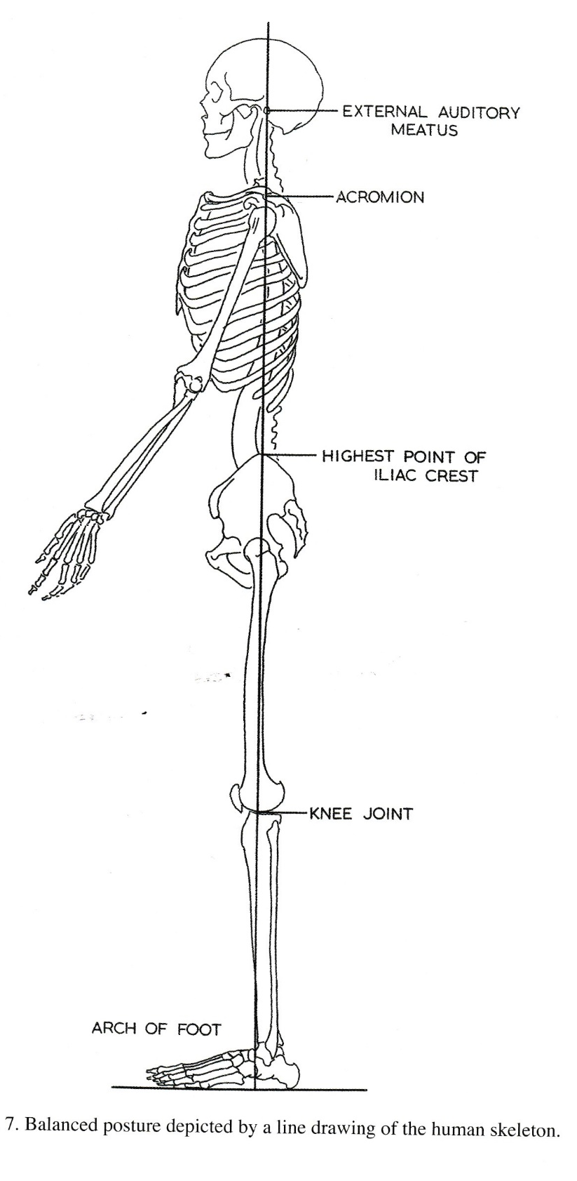
Good posture for singing

Slide 4
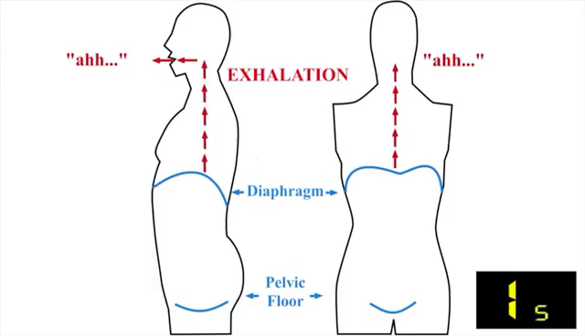
Breathing

Slide 5
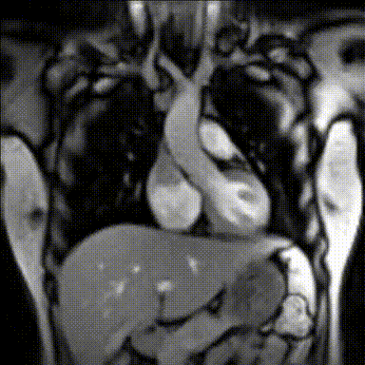

Slide 6
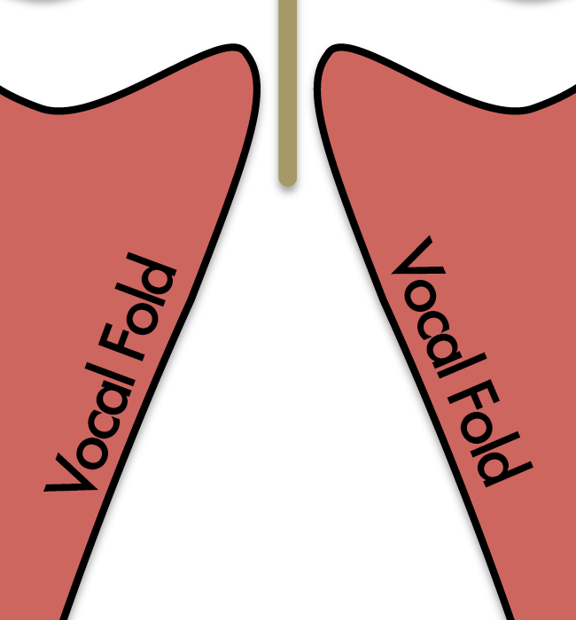
Phonation
Pitch is determined by the length, tension and pressure of the vocal folds.

Slide 7
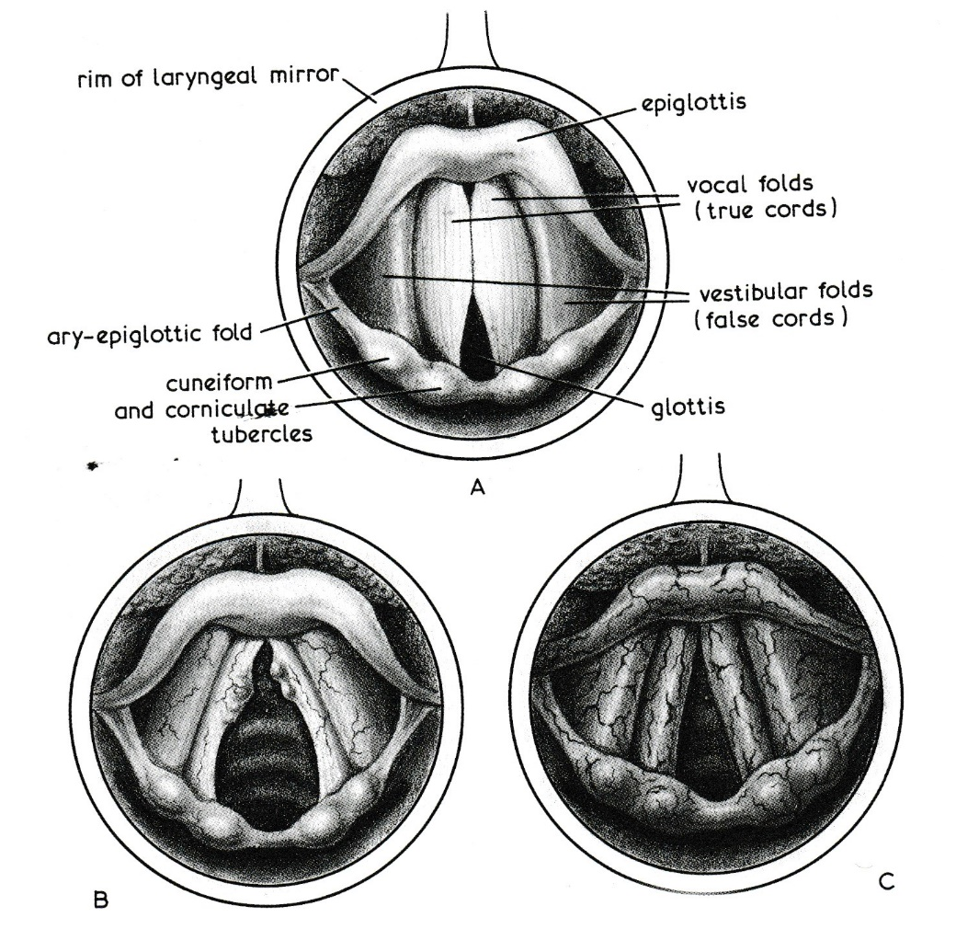
The vocal folds inside the larynx

Slide 8
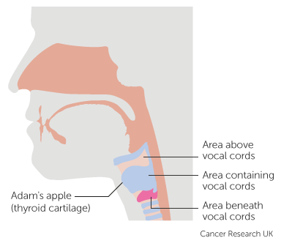
What is the larynx (the voice box)?
The larynx is a tube about 5cm long that sits on the top of your Trachea.
The top of the larynx is the epiglottis, this folds over and covers the trachea during swallowing.
3 different parts of it:
  Supraglottis (above the folds)
  Glottis – (the folds themselves)
  Subglottis – (below the folds)

Slide 9
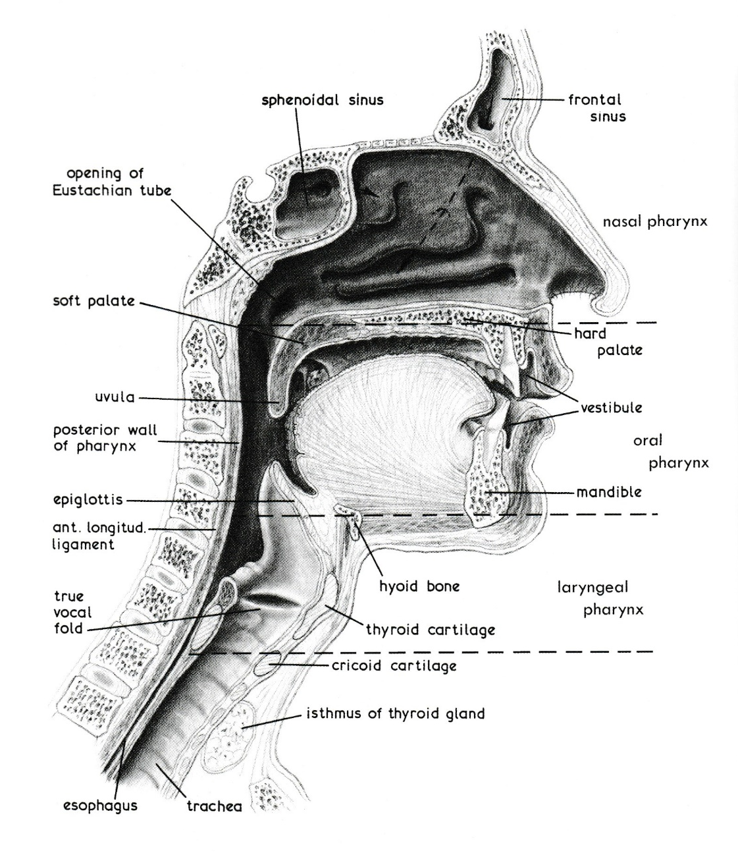
Here’s what it looks like

Slide 10
Singing pointers for KS1
Posture: standing one foot apart when avoiding tilt of the head or lifting shoulders when singing.
Breathing: singing in 2 bar phrases with ease.
Phonation: flexible vocal range between C4 to E5; pure treble sound; matching their singing voice to their speaking voice.
Pitch recognition: Soh, Mi and Doh (5th, 3rd and tonic)
Musicianship: singing using call and response; introduce rounds at 7yrs old.

Slide 11
Singing pointers for KS2
Posture: standing one foot apart when avoiding tilt of the head or lifting shoulders when singing.
Breathing: singing in 4 bar phrases with ease, using
Phonation: flexible vocal range between C4 to E5; smooth pure treble sound; use of chest voice and head voice.
Pitch recognition: flexible singing a full octave
Musicianship: singing using call and response; singing in three part rounds and part-songs.

Slide 12
CPD Singing Resources used
KS1
Bought me a cat
Sally go round the sun
KS2
Obwissana
Senua Dedende
Big Sing
Aye Mojinumba

