Slide 1

Sing Your Own Song
Creating and singing rounds

Slide 2
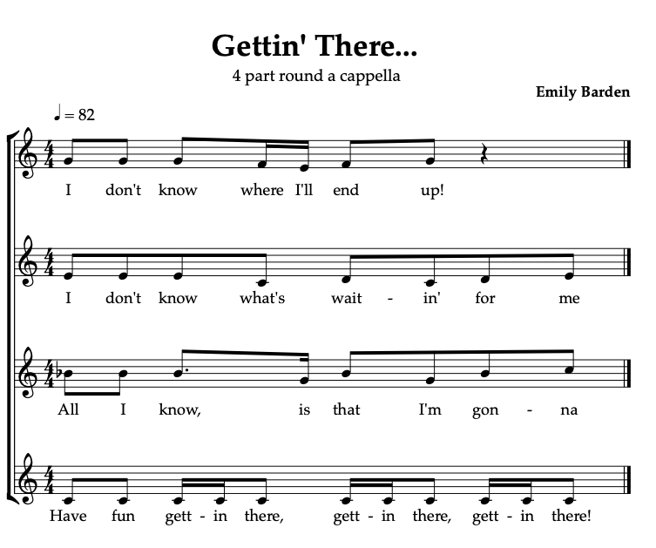
Getting’ There by Emily Barden
4 part warm up round

Slide 3
How do rounds work..?
Each line follows the same harmonic structure so they will work when layered up. This means the same chords work underneath each one of the melodies.
Because they only require a small amount of lyrical and melodic content, rounds are a good way into songwriting and part/harmony singing
Let’s try writing our own following the module Round Britten from www.fridayafternoonsmusic.co.uk
https://brittenpearsarts.org/friday-afternoons/resource/a-round-britten-how-to-write-a-round

Slide 4
Teaching a round:
Really important to ensure solid unison singing first.
Take time with each phrase to learn and embed accurately
Use gesture and physical shape to follow the line of the music – help internalise the shape of each phrase
Make sure there is a strong pulse kept throughout. There needs to be a solid foundation to build your round on, otherwise it will be musical chaos..! (Try Everybody Clap as a good warm up for pulse keeping that also happens to be a round!!)

Slide 5
Start with a 2 part round – understand clearly where the entrance point is for the second part, and show with a clear gesture when it is time for the second part to start. Equally ensure a clear gesture when it is time for each part to stop..!
Enlist the help of confident students to act as song leaders for each part to help you having to juggle all the parts yourself…
Build up from 2 part to 3 part to eventually a 4 part round. Take time and ensure each part is established and happy before splitting again. This can take weeks, and that’s ok.
Great for singing assemblies – teach the unison melody in class music lessons –use singing assembly as a chance to take advantage of more voices to create a round.
You can create an additional dimension to a round by taking one of the lines and repeating it as an ostinato, either vocally or on an instrument.

Slide 6

Resource ideas
Trad Rounds: London’s Burning, Frere Jacques.
Use as melody template to rewrite lyrics to get used to the idea of matching syllables and creating nice phrases to sing…
Some good contemporary Rounds on Sing Up:
Smile
Butterfly
Tue Tue
The Snow is Falling
www.fridayafternoonsmusic.co.uk FREE songbank
Rounds Playlist

